Slide 1
SOC
Embedded Systems

Slide 2
Agenda
AXI Protocol
  Overview
  Master
  UART
  GPIO
  PS2
  VGA

Slide 3
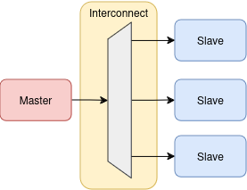
AXI Protocol
The AXI protocol provides a standard for communication and data transfer between IP blocks within an SoC, allowing for efficient and scalable interconnects. It helps in achieving high throughput and minimizing latency in complex digital systems.
Interfaces:
The AXI architecture defines three main types of interfaces
AXI4
AXI4-Lite
AXI4-Stream
AXI Lite was chosen, representing a reduced and simplified variant of the AXI protocol.

Slide 4
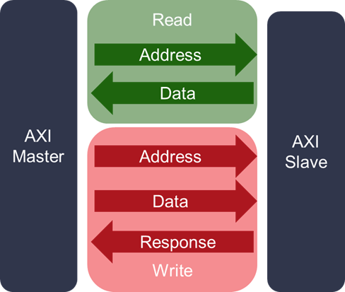
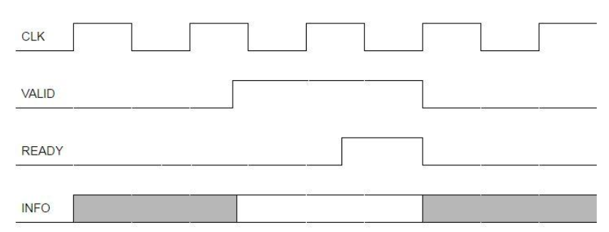
AXI Lite Protocol
Operations:
Read:
Write:
Master <-> Slave
> ARVALID
> ARADDR
< RVALID
< RDATA
> RREADY
Master <-> Slave
> AWVALID
> WVALID
> WDATA
> AWADDR
< BVALID
> BREADY
Handshake:
The VALID signal indicates that the data is valid to be transferred and the READY indicates that the component is ready to accept data or commit the transaction.

Slide 5
AXI MASTER

Slide 6
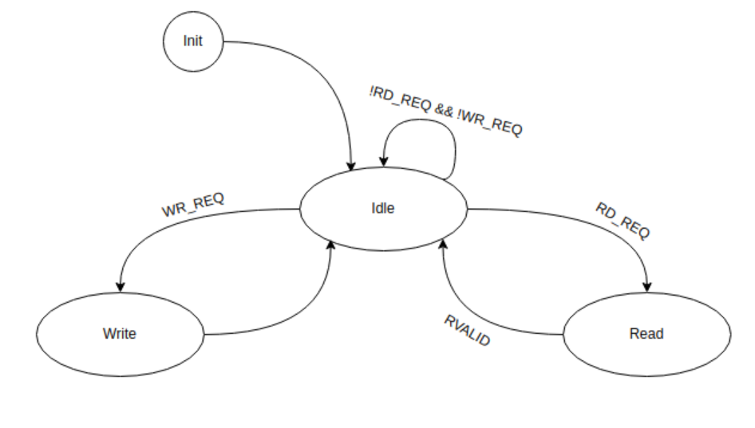
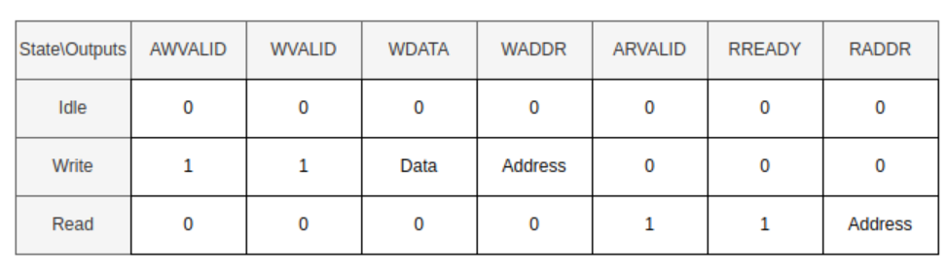
Master Read/Write Design

Slide 7
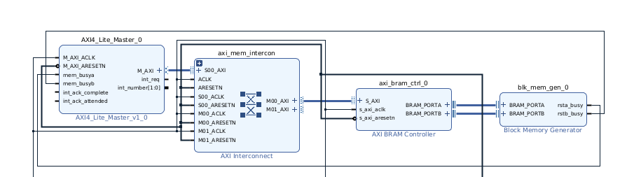
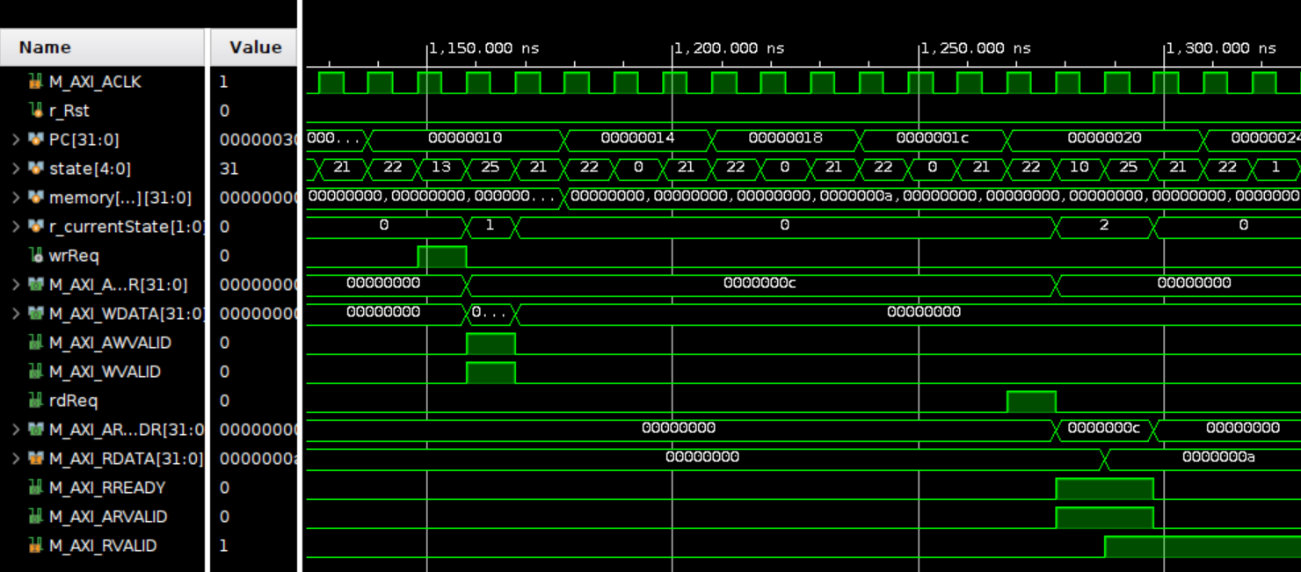
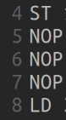
AXI Master TB

Slide 8
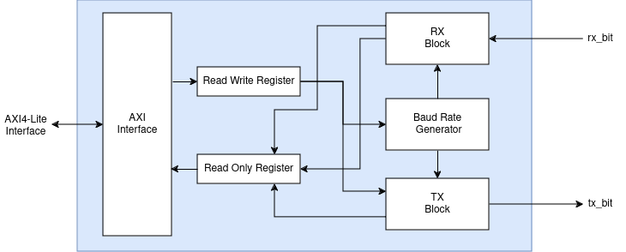
UART
2 Registers added for the interface with the AXI
  ReadWrite Register
  ReadOnly Register

Slide 9
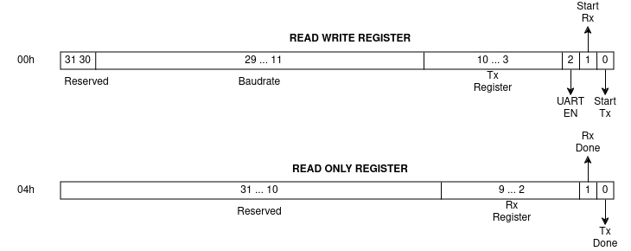
UART
IP Slave Registers

Slide 10
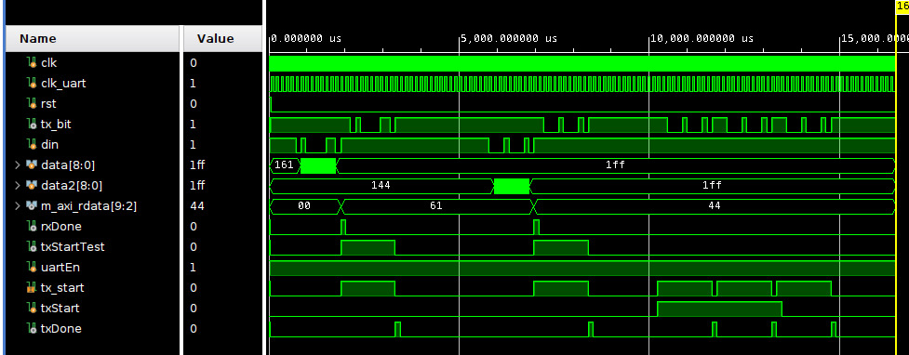
UART
Testbench
  Reception of a character
  Transmission of the same character

Slide 11
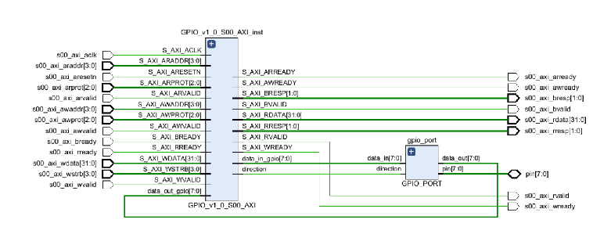
GPIO
RTL Block Design

Slide 12
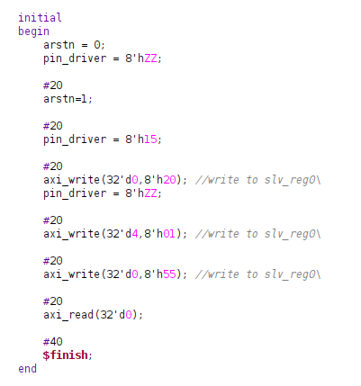
GPIO
TestBench

Slide 13
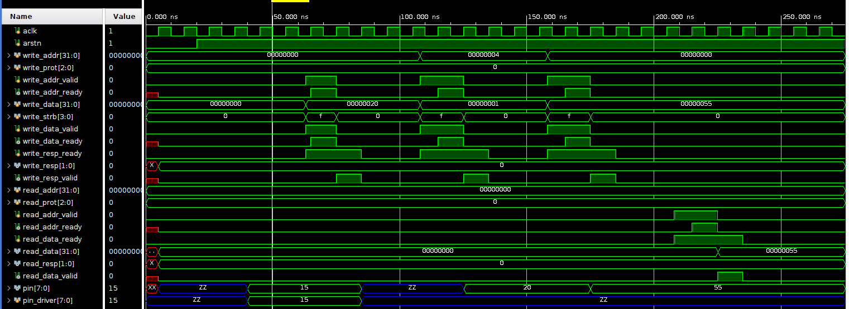
GPIO
Simulation

Slide 14
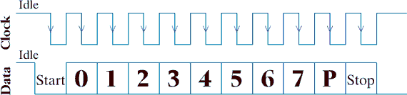
PS2
PS2 Overview

Slide 15
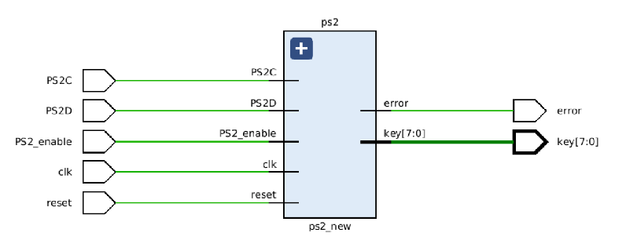
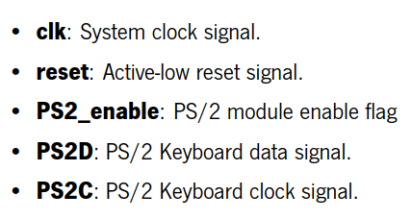
PS2
RTL Block Design

Slide 16
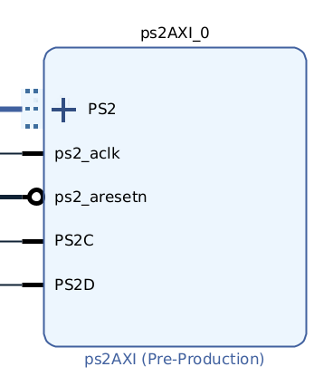
PS2
Generated IP

Slide 17
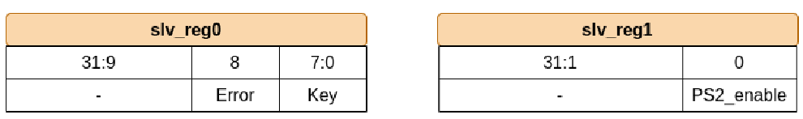
PS2
IP slave registers

Slide 18
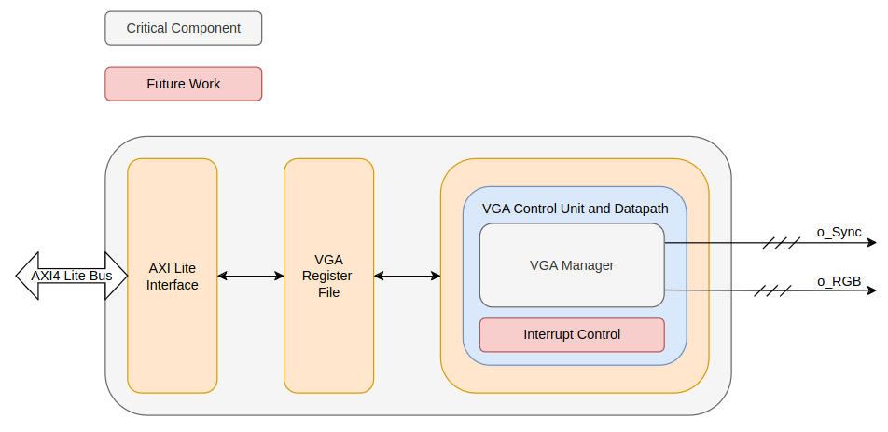
VGA
Overview

Slide 19
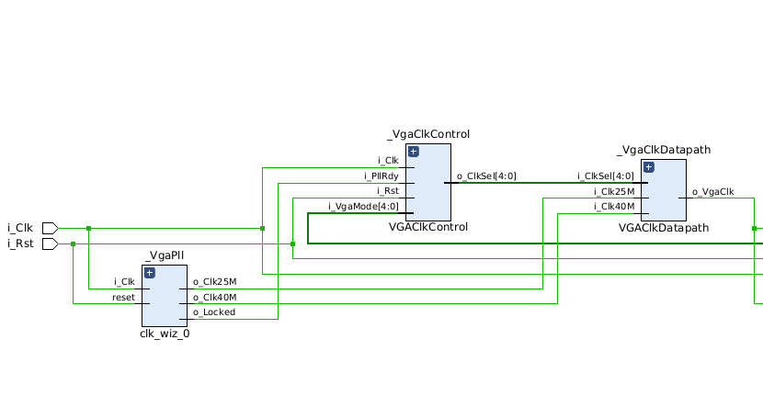
VGA
RTL Block Design

Slide 20
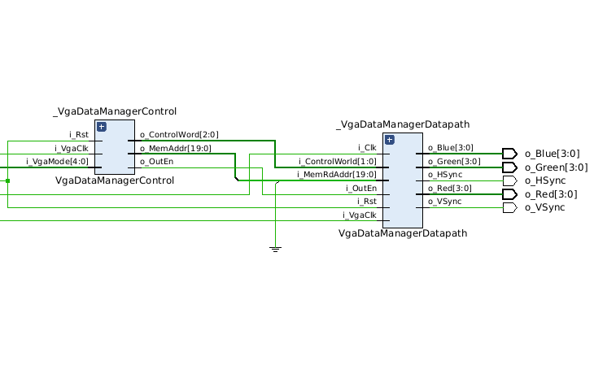
VGA
RTL Block Design

Slide 21
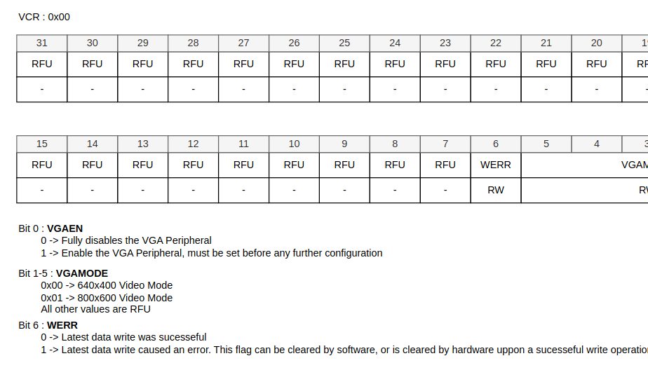
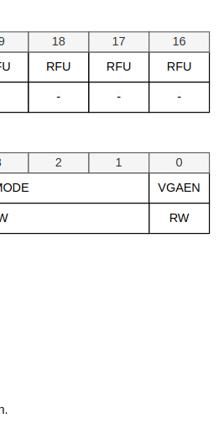
VGA
Registers

Slide 22
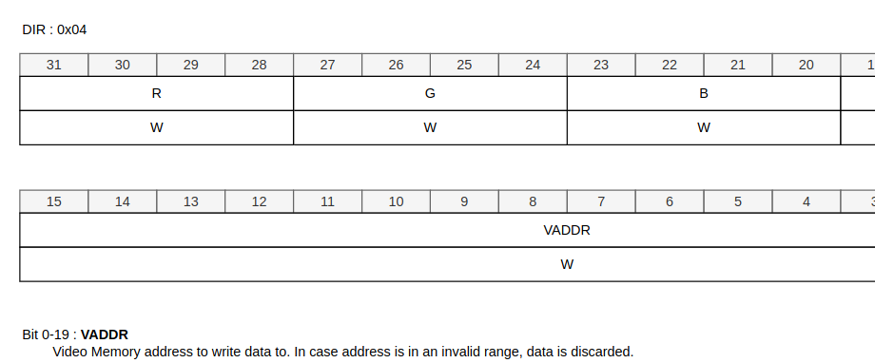
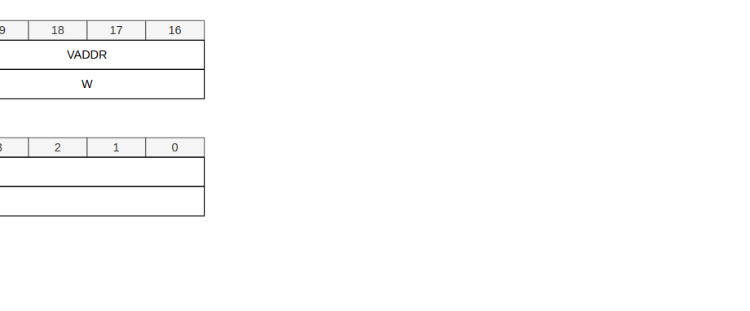
VGA
Registers

Slide 23
Thank you for your attention!

